Slide 1
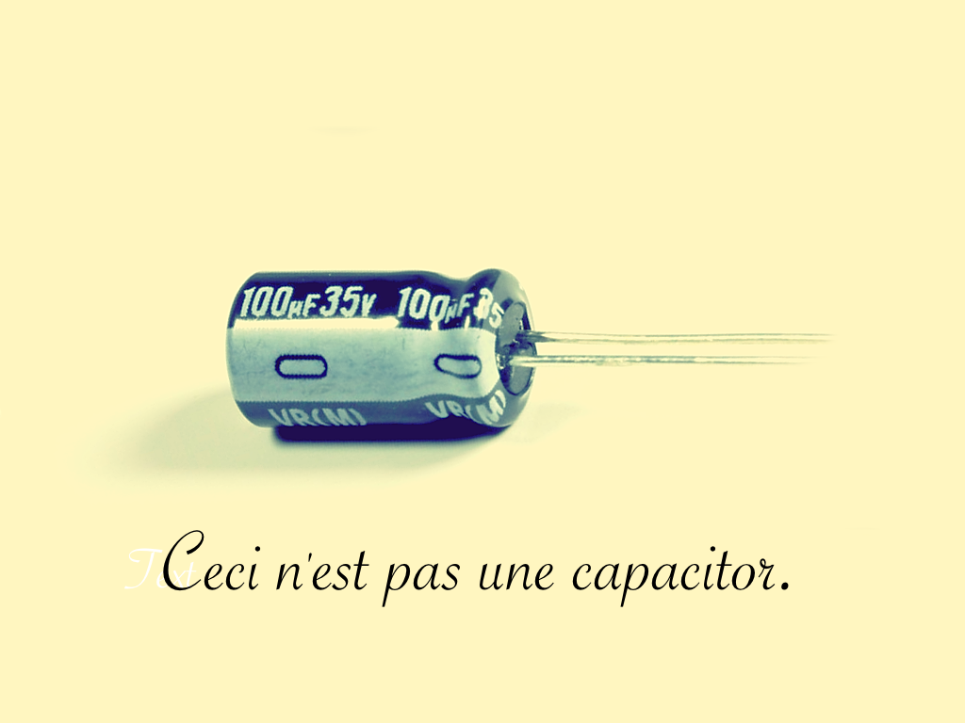
Exercise
Each group characterizes one capacitor and one inductor
Send
1: electrical circuit model (Inductor: L,ESR
Capacitor: C, ESR, ESL)
2: measured model parameters
3: plot of impedance Z=f(Hz): include amplitude and angle plot as function of frequency on a logarithmic scale.
4: picture of inductor and capacitor
5: picture of measurement setup
6: type of instruments used
to
smn@et.aau.dk

Slide 2





1. Electrical circuit model
Circuit model of a Capacitor:
$$C_{C}$$
$${ESR}_{C}$$
$$ESL$$
Circuit model of an Inductor:
$${ESR}_{L}$$
$$L$$

Slide 3
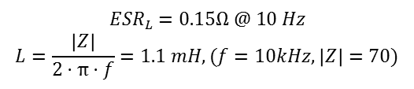
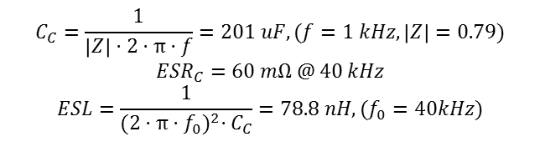
2. Measured model parameters
Capacitor parameters (from figure):
$$C_{C}=\frac{1}{\left|Z\right|·2·π·f}=201 uF,(f=1 kHz,\left|Z\right|=0.79)$$
$${ESR}_{C}=60 mΩ @ 40 kHz$$
$$ESL=\frac{1}{{(2·π·f_{0})}^{2}·C_{C}}=78.8 nH,(f_{0}=40kHz)$$
Inductor parameters (from figure):
$${ESR}_{L}=0.15Ω @ 10 Hz$$
$$L=\frac{\left|Z\right|}{2·π·f}=1.1 mH,(f=10kHz,\left|Z\right|=70)$$

Slide 4
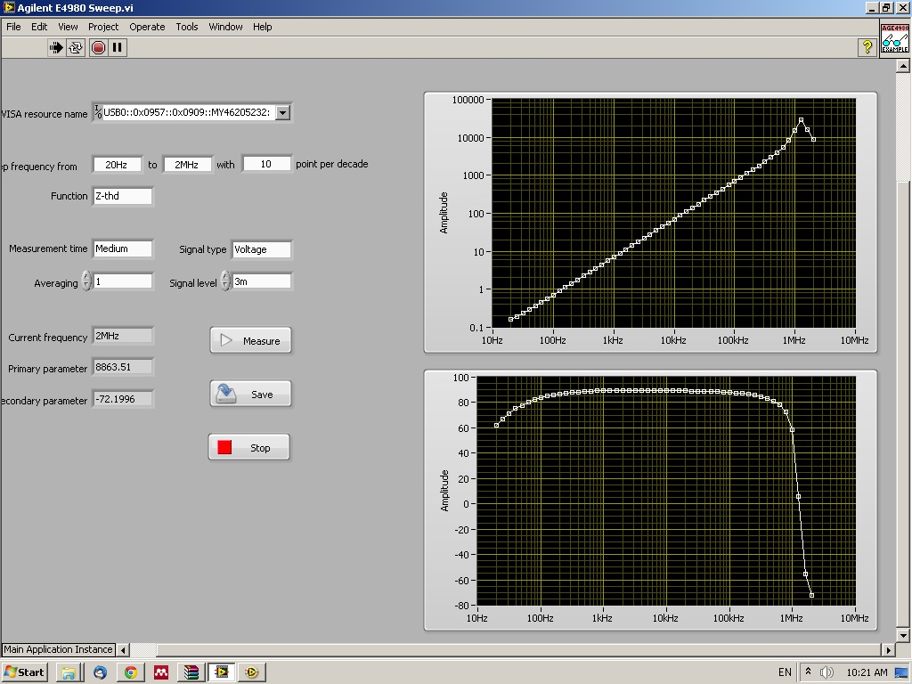
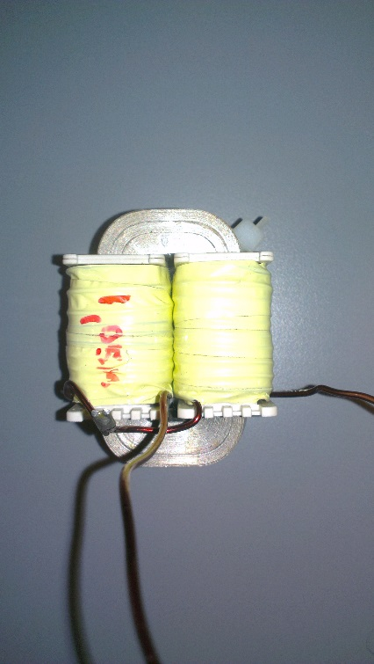
3/4. Plot of impedance Z=f(Hz) including amplitude and angle
Inductor measurement:
Frequency: 20Hz – 2MHz
Inductor type: ?

Slide 5
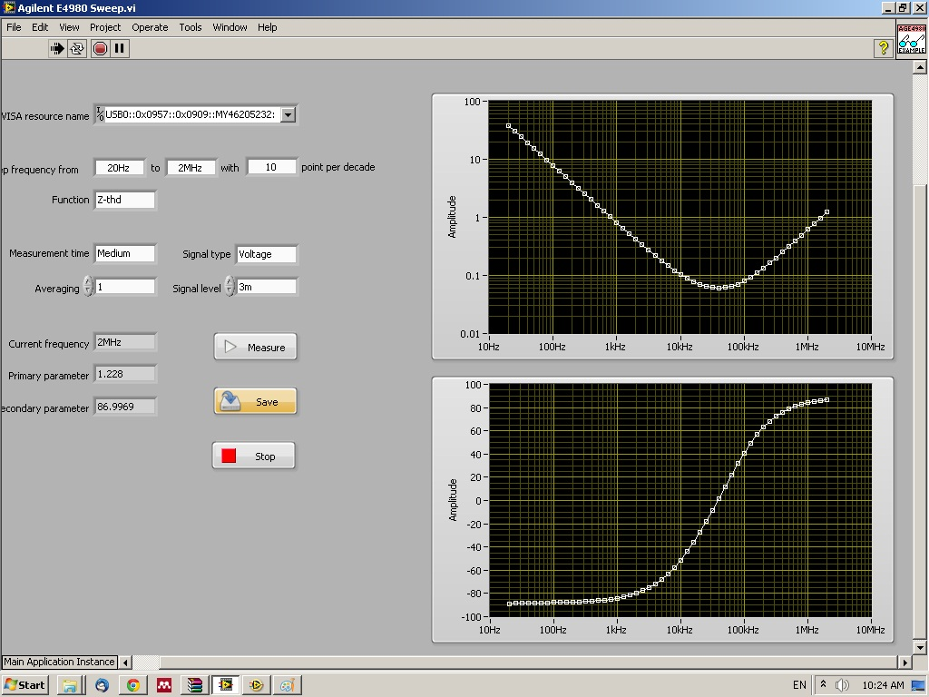
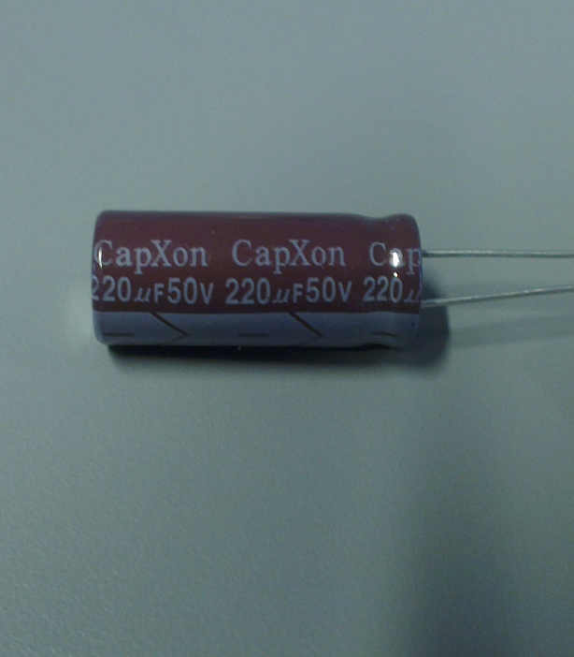
3/4. Plot of impedance Z=f(Hz) including amplitude and angle
Capacitor measurement:
Frequency: 20Hz – 2MHz
Capacitor type: CapXon 220 uF, 50V

Slide 6
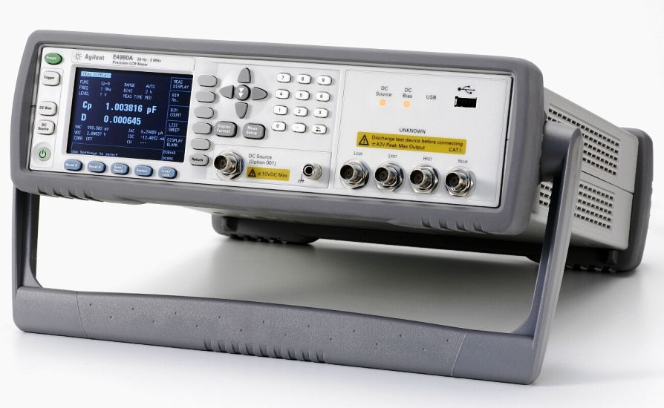
6. Type of instruments used
Instrument:
Agilent E4980A
PC with LabView for controlling the frequency sweep

